Slide 1
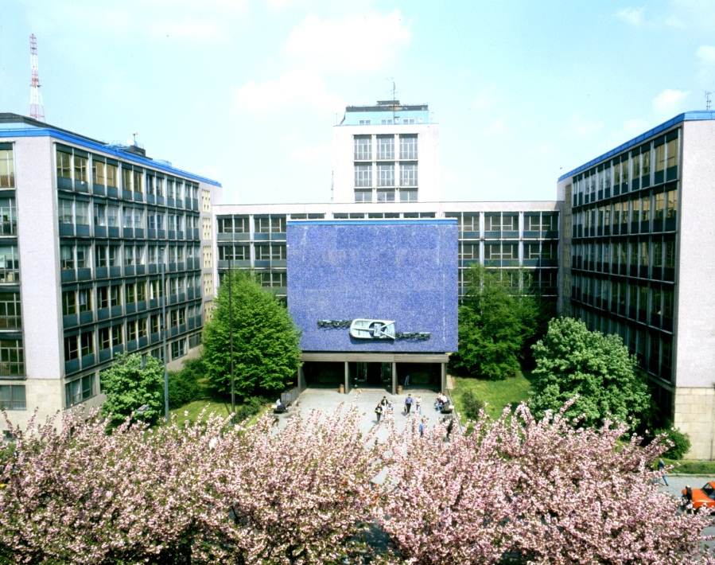
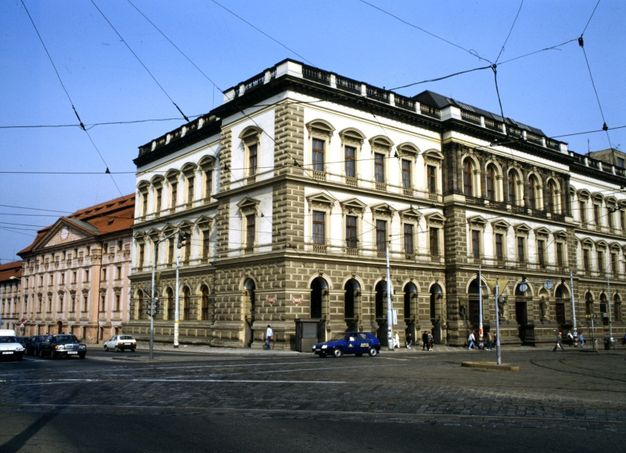
Information and Motivation Meeting for New Doctoral Students CTU FEE September 6, 2022

Slide 2
Rules and Duties – SEC (SZŘ), DSC (ŘDS), DD (SD)
ISP: list of courses & other duties (e.g. stay abroad) – submit by Sept 30
Study duties: min. 2 courses, semester evaluation form, deadlines and study checkups/examinations
Publication duties: WoS Jimp Q1-Q3 / MathSciNet / CORE A*/A conf. paper (min. 3 papers totally)
Internationalization required (typ. internship abroad, min. 1 month, 3-6 recommended) For study interruption/leave for parenting - application needed
 |  | Past credit system not applicable for students starting Sept 1, 2022 |  |  |  | Current non-credit system
Stage | Time | Credits Publications | Credits Courses | Credits Total | Note. | Publications | Courses | Note.
Study stage | 1y |  | 8 | 8 |  |  | min. 1
 | 2y +1m | 3 (~1x conf. paper) | 16-20 | 27 | 4-6 courses (1 course = 4 cr.) | 1x conf. paper | min. 2 (totally 100 hours) | Debate + SDE easy to merge
SDE | 3y | 6 (~2x conf. papers) |  | 30 | Debate (thesis report) +SDE difficult to merge
PhD thesis submission | 4y max.6y | 1x Jimp Q1-Q3/ MatchSciNet/ CORE A*/A |  |  | Internationalization until 7y | 2x conf. papers 1x Jimp Q1-Q3/ MatchSciNet/ CORE A*/A (min. 3 papers) |  | Internationalization until 6y (SEC 23.4.2022, Art. 19/7)
Pros
&
Cons

Slide 3
Benefits and Opportunities
Internship abroad, conferences, summer schools & lectures, language study, Scientific Writing, modern technologies and unique devices and sw equipment .. and discovering the unknown.
Supervisor / Supervisor-specialist
An expert and experienced researcher with international colaborations; scientific topic, state-of-the-art; novel findings, and horizons .. means/tools how to get there.
Guardian Angels – Research Office Assistants
Renata Kroutilíková Ing. Kamila Gregorová e-mail: kroutili@fel.cvut.cz e-mail: gregokam@fel.cvut.cz tel: 2 2435 2030 tel: 2 2435 2230
Recommended course(s)

Slide 4
Scientific Writing and Information Support for PhD Students
D32SWE Scientific Writing and Publishing in English, https://bit.ly/3BcqIyh, prof. Zeman, Faculty of Civil Engineering, university course
XEP17SWR Scientific Writing - prof. Jeff Frolik, Fulbright Scholar 2022 (typically for students in 2nd – 3rd year, paper in progress is advisable/required)
XP37MPV Scientific Work Methodology, XP17MVP Metodika vědecké práce
English exam – XP04MIN -> ISP (the details will be provided by Dept. of Languages)
E-learningový kurz: Informace pro vědu a výzkum, organizovaný ÚK ČVUT
Přednášející: Mgr. Michaela Morysková, Mgr. Lenka Hrdličková, Ph.D., ÚK ČVUT
http://knihovna.cvut.cz/seminare-a-vyuka/vyuka/e-learningovy-kurz#2
Obsah: Služby a nástroje ÚK ČVUT pro doktorandy
Informační zdroje pro technické obory na ČVUT
Přístup k odborným informacím na ČVUT
Citační nástroje
Základy vědeckého publikování

Slide 5
Last but not Least .. + motivation to finish the study in 4y
Scholarship/Income .. at least 15 000 CZK/month (scholarship until 4y), other resources available for good/excellent students.
Dean’s Award for Prestigieous Disertation Thesis (.. looks good in CV ☺)
Don’t leave matters (especially publications!) to the last minute. Plan it ahead.
Take a chance and do things /research/ with your heart.
Q? The hand that will always help you is ..
T. Jefferson: I am a great believer in luck. I find the harder I work, the more I have of it.
Good luck and a great diligence!
https://fel.cvut.cz/en/education/phd/study.html
https://fel.cvut.cz/cz/vv/studium.html

